Slide 1
Office 365 Management API Introduction
APAC SCIM EEE
Dongli Pan
APAC MW SE
Haoran Bi
APAC MW SE
Qi Dong

Slide 2

Purpose
1. Introduce Office365 management API
2. Engage correct team
3. Collect basic information
4. Introduce PowerShell module for Office365 management API

Slide 3
Agenda
What is Office365 Management API
How to call Office365 Management API
Troubleshooting & tips
Introduce PowerShell module for Office365 management API
Notes:
Original Content: Agenda: 1. What is Management API 2. Compare with Graph API 3. How to use Management API 4. Troubleshooting

Slide 4

Part 1: What is Office 365 Management API
Notes:
Original Content: Part 2 compare with Graph API 1. The O365 Management API was created earlier. Many 3rd party applications such as Splunk are using it. 2. Graph API provides Directory audits, Sign-ins. 3. Graph API has change notifications but not including all audit log. 4.

Slide 5
Part 1: What is Management API Definition
Official definition:
The Office 365 Management APIs provides a single extensibility platform for all Office 365 customers' and partners' management tasks, including service communications, security, compliance, reporting, and auditing. All of the Office 365 Management APIs are consistent in design and implementation with the current suite of Office 365 REST APIs, using common industry-standard approaches, including OAuth v2, OData v4, and JSON. Like the other Office 365 APIs, applications are registered in Microsoft Entra ID, giving developers a consistent way to authenticate and authorize their apps. M365 audit log is saved into AAD cache.
In short, help the customers get massive audit records via REST API

Slide 6
Part 1: What is Management API Definition
The auditing service collects the audit records from relevant workloads(Exchange, SharePoint, AzureAD, Security,etc) and save them to Azure AD cache and M365 internal AuxAuditing mailboxes. O365 ManamgementAPI retrieve the data from this AzureAD cache. After 7 days, the auditing blob will be removed from AzureAD cache.
There are 2 types of Office 365 Management API: Office 365 Service Communications API (retired and Graph API replaces) and Office 365 Management Activity API.
For different environments, we have relevant resource URLs:
Commercial: https://manage.office.com
GCC government: https://manage-gcc.office.com
GCC High government: https://manage.office365.us
DoD government: https://manage.protection.apps.mil
GallatinPlan: https://manage.office365.cn

Slide 7
All are around auditing. We can have the resources below until now.
Audit.AzureActiveDirectory
Audit.Exchange
Audit.SharePoint
Audit.General (includes all other workloads not included in the previous content types)
DLP.All (DLP events only for all workloads)
Part 1: What is Office365 Management API Scope

Slide 8
Part 1: What is Office365 Management API Process
Request
User actions
Office Endpoints
Audit service
Customer’s server
Webhook

Slide 9
Part 1: What is Management API Webhook
Webhook: A webhook is a mechanism that allows applications to push real-time information to other applications. It operates through HTTP callbacks, enabling event notifications between servers. The working principle of webhooks is based on the publish/subscribe model, where one application registers interest in specific events with another application, and once an event occurs, data is pushed directly to a predefined URL.
Compared with Polling, it is real-time and Lightweight.
Compared with WebSocket, it is Lightweight and Simple Configuration
Use Azure Function demo to play webhook with Office365 Management API

Slide 10
Part 2: How to call Office 365 Management API

Slide 11
Part 2: How to use Management API Pre-requirement
Need to use Oauth authentication. Register an app in Microsoft Entra ID to manage permissions and generate token

Slide 12
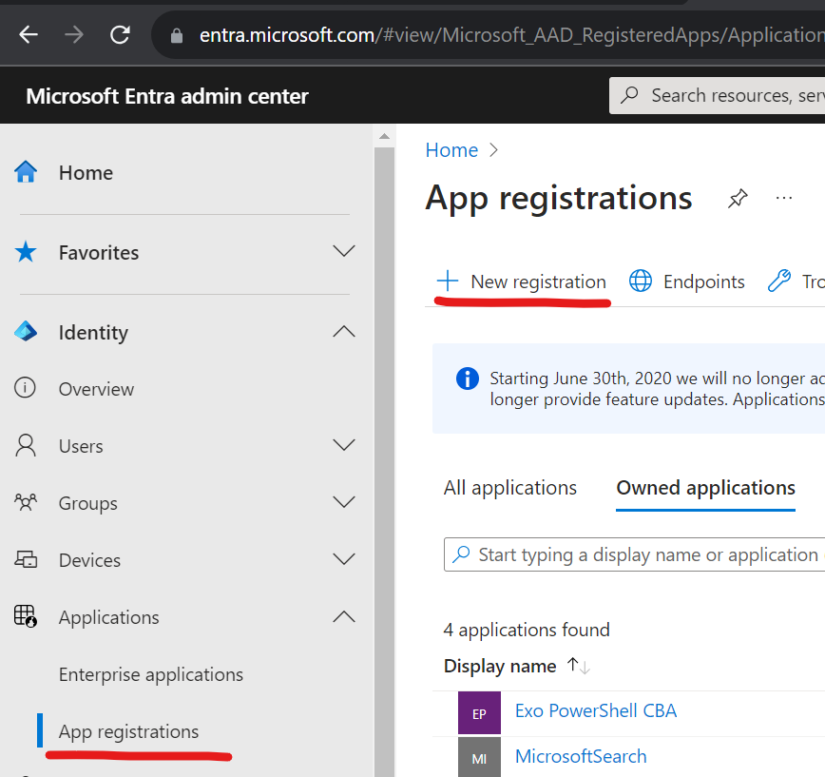
Step 1: Register your application in Microsoft Entra ID
Create a new registration in Applications -> App registrations
On the Register an application page, do the following things and click on Register
Name your app
Choose who can use the app and access the API
Provide a redirect URL for user redirect after authentication, if needed.
After creation, we can have below three IDs
Application (Client) ID
Object ID
Directory (tenant) ID

Slide 13
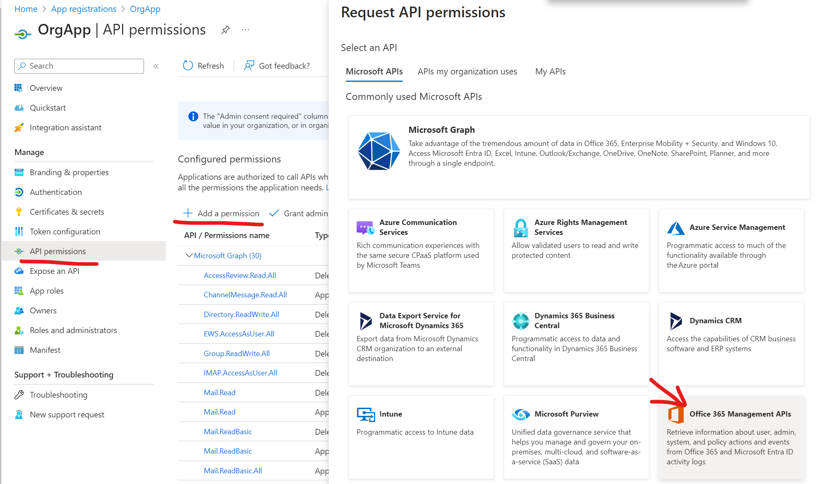
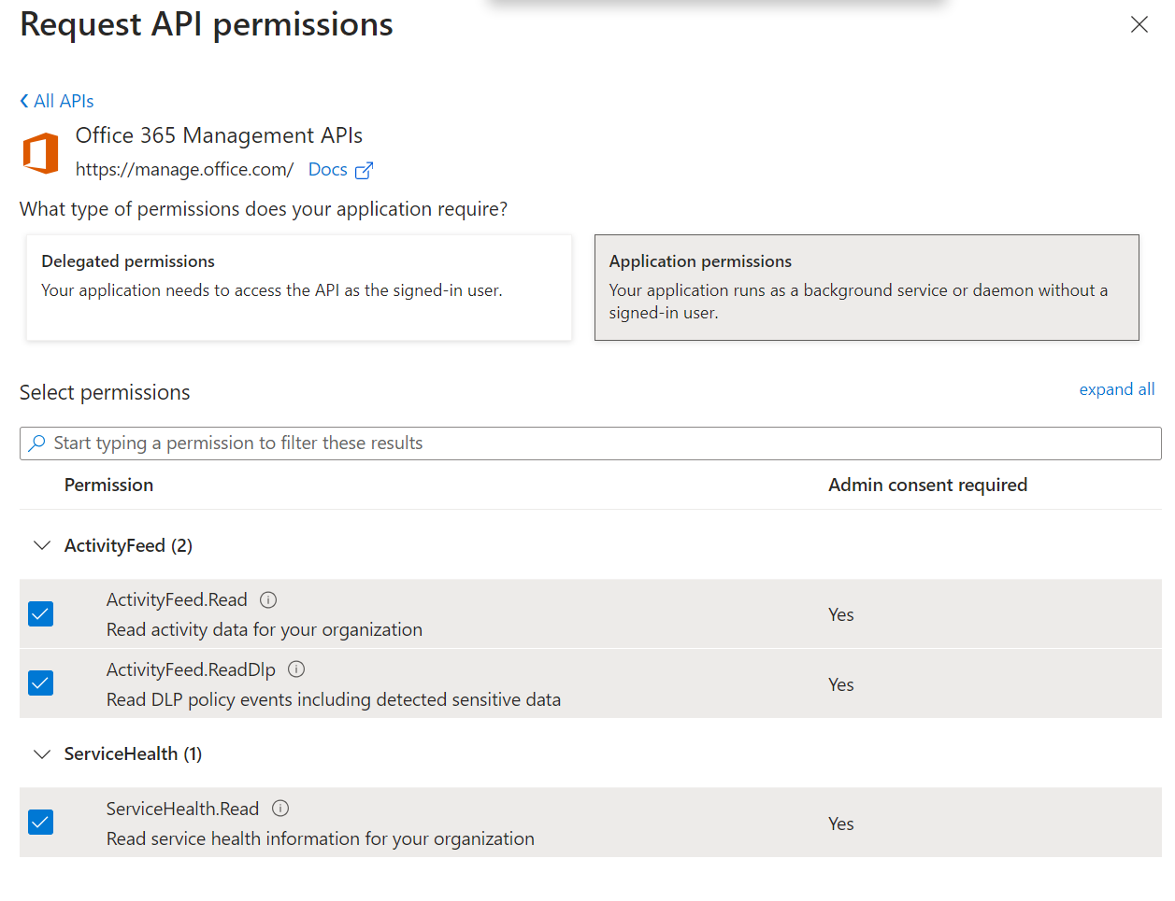
Step 2: Get Office 365 tenant admin consent
Go to API permissions and add a permission for Office 365 Management APIs. Choose the type of permissions and select all permissions listed
Delegated Permissions: enables client app to perform operations on behalf of the signed-in user
Application Permissions: enables client app to authenticate as itself without user interaction or consent
Select Grant admin consent for tenant name to consent to the permissions given to your app

Slide 14
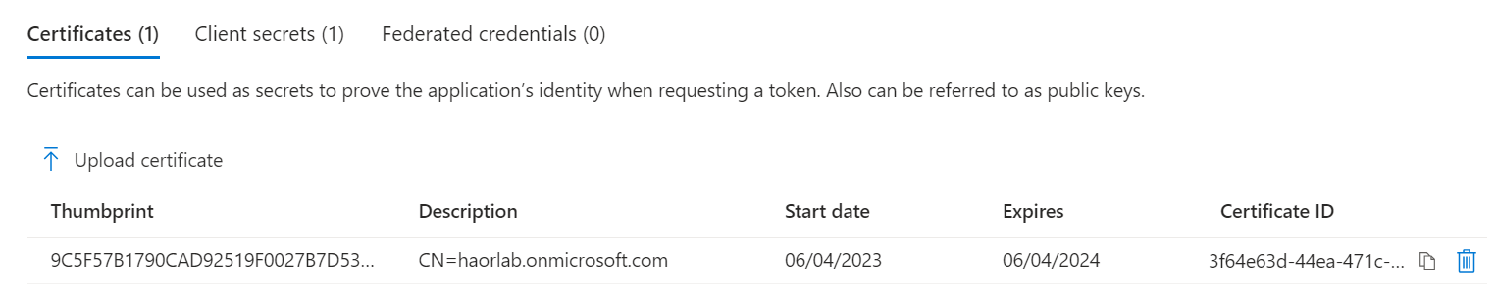
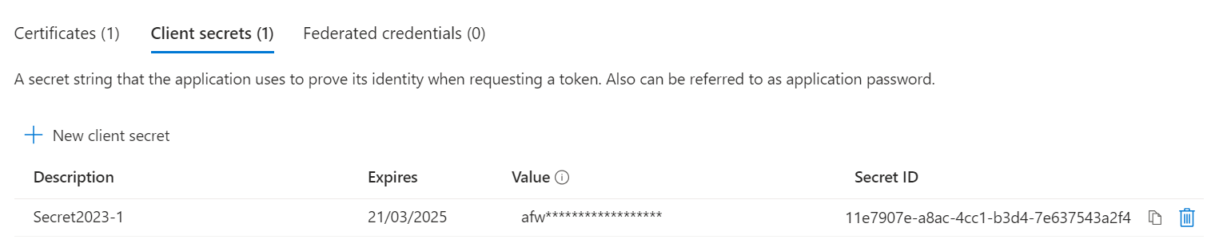
Step 3: Request access tokens from Microsoft Entra ID
Open your application and go to Certificates & secrets
Two options: Client secret or Certificates
For Client secret, click new client secret and note the value
Value will be hidden next time and cannot be double checked
For Certificates, upload your certificate
Certificate can be self-signed

Slide 15

Step 4 Generate a valid token
Many authentication flows from Azure AD(https://learn.microsoft.com/en-us/entra/identity-platform/authentication-flows-app-scenarios)
Use Azure AD authentication library MSAL to get the access token

Slide 16

Part 2: How to use Management API Operations
The Activity API supports the following operations:
Start a subscription to begin receiving notifications and retrieving activity data for a tenant.
Stop a subscription to discontinue retrieving data for a tenant.
List current subscriptions
List available content and the corresponding content URLs.
Receiving notifications sent by a webhook when new content is available.
Retrieving content by using the content URL.
List notifications sent by a webhook.
Retrieve resource friendly names for objects in the data feed identified by guids.

Slide 17
Part 2: How to use Management API Start a subscription without Webhook
Sample request:
POST {root}/subscriptions/start?contentType=Audit.SharePoint&PublisherIdentifier=46b472a7-c68e-4adf-8ade-3db49497518e
Content-Type: application/json; utf-8
Authorization: Bearer eyJ0e...Qa6wg

Slide 18
Part 2: How to use Management API Start a subscription without webhook
Sample response:
HTTP/1.1 200 OK
Pragma: no-cache
mise-correlation-id: 4e6a692e-594e-43e6-aad8-9fa7449b3f78
Content-Length: 68
Cache-Control: no-cache
Content-Type: application/json; charset=utf-8
Date: Fri, 01 Dec 2023 11:43:09 GMT
Expires: -1
Server: Microsoft-IIS/10.0
X-AspNet-Version: 4.0.30319
X-Powered-By: ASP.NET
{"contentType":"audit.sharepoint","status":"enabled","webhook":null}

Slide 19
Part 2: How to use Management API Start a subscription with webhook
Sample request:
POST {root}/subscriptions/start?contentType=Audit.SharePoint&PublisherIdentifier=46b472a7-c68e-4adf-8ade-3db49497518e
Content-Type: application/json; utf-8
Authorization: Bearer eyJ0e...Qa6wg
{
"webhook" : {
"address": "https://webhook.myapp.com/o365/",
"authId": "o365activityapinotification",
"expiration": ""
}
}

Slide 20
Part 2: How to use Management API Start a subscription with webhook
After start with webhook enabled, your server will receive one validation request. Only when MS server receives the 200 response from your server, webhook can be enabled.
POST {webhook address}
Content-Type: application/json; charset=utf-8
Webhook-AuthID: (webhook authId, if provided)
Webhook-ValidationCode: (random opaque string)
{
"validationCode": (random opaque string, same as header)
}

Slide 21
Part 2: How to use Management API Start a subscription with webhook
Sample response:
HTTP/1.1 200 OK
Pragma: no-cache
mise-correlation-id: 28953489-5c4b-4021-9993-b3bc519b6996
Content-Length: 179
Cache-Control: no-cache
Content-Type: application/json; charset=utf-8
Date: Fri, 01 Dec 2023 11:54:23 GMT
Expires: -1
Server: Microsoft-IIS/10.0
X-AspNet-Version: 4.0.30319
X-Powered-By: ASP.NET
{"contentType":"audit.sharepoint","status":"enabled","webhook":{"authId":"o365activityapinotification","address":"https://34.87.196.198:8080/","expiration":"","status":"enabled"}}

Slide 22
Part 2: How to use Management API Stop a subscription
Sample request:
POST {root}/subscriptions/stop?contentType=Audit.SharePoint&PublisherIdentifier=46b472a7-c68e-4adf-8ade-3db49497518e
Authorization: Bearer eyJ0e...Qa6wg

Slide 23
Part 2: How to use Management API Stop a subscription
Sample response:
HTTP/1.1 204 No Content
Pragma: no-cache
mise-correlation-id: 9e550ce0-07e9-4ea6-9223-9df1de898b58
Cache-Control: no-cache
Date: Fri, 01 Dec 2023 11:46:48 GMT
Expires: -1
Server: Microsoft-IIS/10.0
X-AspNet-Version: 4.0.30319
X-Powered-By: ASP.NET

Slide 24
Part 2: How to use Management API List current subscriptions
Sample request:
GET {root}/subscriptions/list?PublisherIdentifier=46b472a7-c68e-4adf-8ade-3db49497518e
Authorization: Bearer eyJ0e...Qa6wg

Slide 25
Part 2: How to use Management API List current subscriptions
Sample response:
HTTP/1.1 200 OK
Content-Type: application/json; charset=utf-8
[
{
"contentType" : "Audit.SharePoint",
"status": "enabled",
"webhook": {"status": "enabled", "address": "https://webhook.myapp.com/o365/", "authId": "o365activityapinotification", "expiration": null}
},
...
{
"contentType": "Audit.Exchange",
"webhook": null
}
]

Slide 26
Part 2: How to use Management API List available content
Sample request:
GET {root}/subscriptions/content?contentType=Audit.SharePoint&PublisherIdentifier=46b472a7-c68e-4adf-8ade-3db49497518e&startTime=YYYY-MM-DD&endTime=YYYY-MM-DD
Authorization: Bearer eyJ0e...Qa6wg
For time,
UTC.
In 7 days.
No more 24 hours apart between start and end.
If not specify, API set it to default last 24 hours.

Slide 27
Part 2: How to use Management API List available content
Sample response:
HTTP/1.1 200 OK
Content-Type: application/json; charset=utf-8
[
{
"contentType": "Audit.SharePoint",
"contentId": "492638008028$492638008028$f28ab78ad40140608012736e373933ebspo2015043022$4a81a7c326fc4aed89c62e6039ab833b$04",
"contentUri": "https://manage.office.com/api/v1.0/f28ab78a-d401-4060-8012-736e373933eb/activity/feed/audit/492638008028$492638008028$f28ab78ad40140608012736e373933ebspo2015043022$4a81a7c326fc4aed89c62e6039ab833b$04",
"contentCreated": "2015-05-23T17:35:00.000Z",
"contentExpiration": "2015-05-30T17:35:00.000Z"
},
...
]

Slide 28
Part 2: How to use Management API Retrieving content
URL is the contentURI we have. Send it directly.
GET https://manage.office.com/api/v1.0/41463f53-8812-40f4-890f-865bf6e35190/activity/feed/audit/301299007231$301299007231$41463f53881240f4890f865bf6e35190aad2015062920$e1c2ab19858a469fb1f1fd097effffc9$04 HTTP/1.1
Authorization: Bearer eyJ0e...Qa6wg

Slide 29
Part 2: How to use Management API Pagination
If there are more results in the specified time range than can be returned in single response, the results will be truncated and a header will be added to the response indicating the URL to use to retrieve the next page of results.
HTTP/1.1 200 OK
Content-Type: application/json; charset=utf-8
NextPageUri: https://manage.office.com/api/v1/{tenant_id}/activity/feed/subscriptions/content?contentType=Audit.SharePoint&startTime=2015-10-01&endTime=2015-10-02&nextPage=2015101900R022885001761

Slide 30
Part 2: How to use Management API Retrieving content
Sample response:
HTTP/1.1 200 OK
Content-Type: application/json; charset=utf-8
[
{
"CreationTime": "2015-06-29T20:03:19",
"Id": "80c76bd2-9d81-4c57-a97a-accfc3443dca",
"Operation": "PasswordLogonInitialAuthUsingPassword",
"OrganizationId": "41463f53-8812-40f4-890f-865bf6e35190",
"RecordType": 9, "Workload": "AzureActiveDirectory",
…….
}
]

Slide 31
Part 2: How to use Management API Notifications
POST https://webhook.myapp.com/o365/
Content-Type: application/json; utf-8
Webhook-AuthID: o365activityapinotification
[
{
"tenantId": "{GUID}",
"clientId": "{GUID}",
"contentType": "Audit.SharePoint",
"contentId": "492638008028$492638008028$f28ab78ad40140608012736e373933ebspo2015043022$4a81a7c326fc4aed89c62e6039ab833b$04",
"contentUri": "https://manage.office.com/api/v1.0/f28ab78a-d401-4060-8012-736e373933eb/activity/feed/audit/492638008028$492638008028$f28ab78ad40140608012736e373933ebspo2015043022$4a81a7c326fc4aed89c62e6039ab833b$04",
"contentCreated": "2015-05-23T17:35:00.000Z",
"contentExpiration": "2015-05-30T17:35:00.000Z"
},
...
]

Slide 32
Part 2: How to use Management API List notifications
Sample request:
GET {root}/subscriptions/notifications?contentType=Audit.SharePoint&PublisherIdentifier=46b472a7-c68e-4adf-8ade-3db49497518e&startTime={0}&endTime={1}
Authorization: Bearer eyJ0e...Qa6wg

Slide 33
Part 2: How to use Management API List notifications
Sample response:
HTTP/1.1 200 OK
Content-Type: application/json; charset=utf-8
[
{
"contentType": "Audit.SharePoint",
"contentId": "492638008028$492638008028$f28ab78ad40140608012736e373933ebspo2015043022$4a81a7c326fc4aed89c62e6039ab833b$04",
"contentUri": "https://manage.office.com/api/v1.0/f28ab78a-d401-4060-8012-736e373933eb/activity/feed/audit/492638008028$492638008028$f28ab78ad40140608012736e373933ebspo2015043022$4a81a7c326fc4aed89c62e6039ab833b$04",
"contentCreated": "2015-05-23T17:35:00.000Z",
"contentExpiration": "2015-05-30T17:35:00.000Z",
"notificationSent": "2015-05-23T17:36:00.000Z",
"notificationStatus": "success"
},
...
]

Slide 34
Part 2: How to use Management API Retrieve resource friendly names
What I can say is ignoring it. No one will use it. If any customer wants to use it, just tell them
"DlpSensitiveType" is the only supported object.
And let them go.
This just return DLP sensitive type name like below.
HTTP/1.1 200 OK [ { "id": "50842eb7-edc8-4019-85dd-5a5c1f2bb085", "name": "CreditCardNumber" }, { "id": "0e9b3178-9678-47dd-a509-37222ca96b42", "name": "EUDebitCardNumber" }, ... { } ]

Slide 35
Part 3: Troubleshooting & Tips

Slide 36
Ask customer to check with 3rd party first
Checking if audit log is enabled
Checking the access token with relevant API permissions
Collect request and response
Try to retrieve data directly
Engage PG with contentURI
Part 3: Troubleshooting Normal process

Slide 37
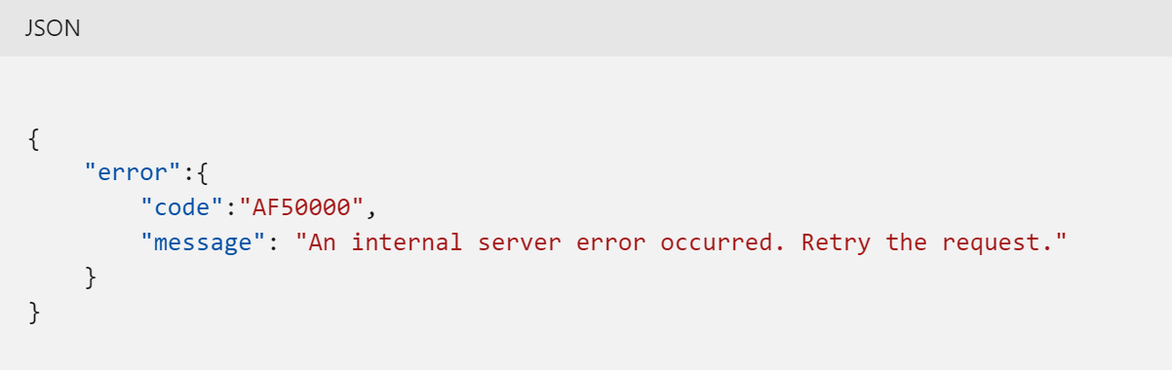
Part 3: Troubleshooting & tips
When the service encounters an error, it will report the error response code to the caller, using standard HTTP error-code syntax. The customer needs to collect the response body and share to our support team & PG.
Refer to https://learn.microsoft.com/en-us/office/office-365-management-api/office-365-management-activity-api-reference#errors

Slide 38
Part 3: Troubleshooting & tips
throttling
Response Code 403: {'error':{'code':'AF429','message':'Too many requests. Method=GetBlob, PublisherId=00000000-0000-0000-0000-000000000000'}}
All organizations are initially allocated a baseline of 2,000 requests per minute. This is not a static, predefined limit but is modeled on a combination of factors including the number of seats in the organization and that Office 365 and Microsoft 365 E5 organizations will get approximately twice as much bandwidth as non-E5 organizations.

Slide 39
Part 3: Troubleshooting & tips
PublisherIdentifier
The tenant GUID of the vendor coding against the API. This is not the application GUID or the GUID of the customer using the application, but the GUID of the company writing the code. This parameter is used for throttling the request rate. Make sure this parameter is specified in all issued requests to get a dedicated quota. All requests received without this parameter will share the same quota. PublisherIdentifier is no longer used for quota calculation. PublisherIdentifier is an optional field from PG’s feedback.
If issue persists with publisheridentifier specified, double check their logic to ensure it is good.
If cx really need to increase throttling limit, engage PG.

Slide 40
Part 3: Troubleshooting & tips
Content delay/missing
Typically, most notifications are sent within one hour of the event. But no SLA guarantee.
PG/EEE can help to check the generation time using contentUri. Most time, this is caused by workload delay. We need to engage relevant workload team.
After the audit data is saved to Azure AD cache, it will be kept for 7 days.
When the customers can’t get the complete data, please check how they download the data. Whether there are any network devices. We can check whether they can get all content blobs and whether they can download the complete content data.

Slide 41
Part 3: Troubleshooting & tips
What if customers do not trust our data?
Microsoft doesn't provide any kind of a log that allows cx to cross-check any given application or third-party (ISV) application.
They are required to compare their data and tell us what is wrong. We can engage PG to verify if data is accurate.

Slide 42
Part 3: Troubleshooting & tips
For webhook, list notification to confirm if there is failed notification. It is rare that our customers are using webhook to get the audit data.
The notification system sends notifications as new content becomes available. If we encounter excessive failures when sending notifications, our retry mechanism will exponentially increase the time between retries. If we continue to encounter failures, we reserve the right to disable the webhook and stop sending notifications to it altogether.

Slide 43
Part 4:PowerShell module for Office365 management API

Slide 44
ZIZHUOffice365ManagementAPI introduction
Github project link/PS gallery link
PowerShell module for Office365ManageAPI calling
IT Admin can use this PowerShell module to call Office365ManagementAPI
It supports all operations of Office365ManagementAPI and webhook subscriptions and notifications
Our support team can use this module to diagnose the issues
Just finish the coding and some basic tests for Commercial. Will test further and add some features like log

Slide 45
Demo: Install /Import module
Install-Module -Name ZIZHUOffice365ManagementAPI
Import-Module -Name ZIZHUOffice365ManagementAPI

Slide 46
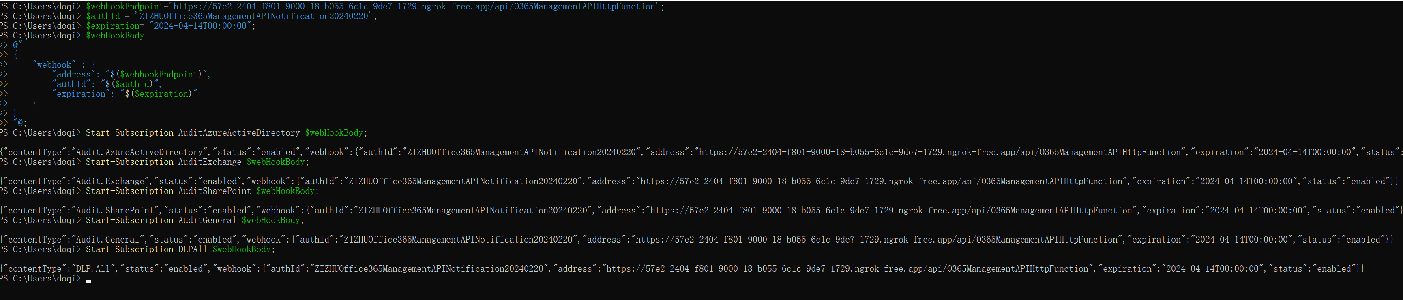
Demo: Start the subscriptions with webhook
If we do not pass webhook body, the subscription is normal without the webhook

Slide 47
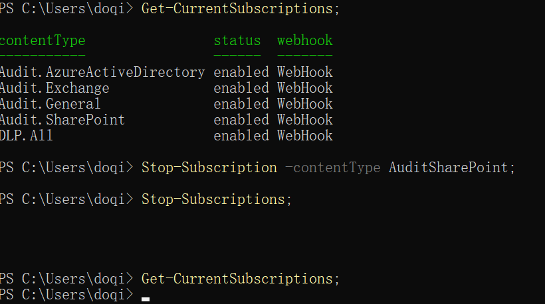
Demo: Get current subscriptions/Stop subscriptions
Get-CurrentSubscriptions;
Stop-Subscription -contentType AuditSharePoint;
Stop-Subscriptions;

Slide 48
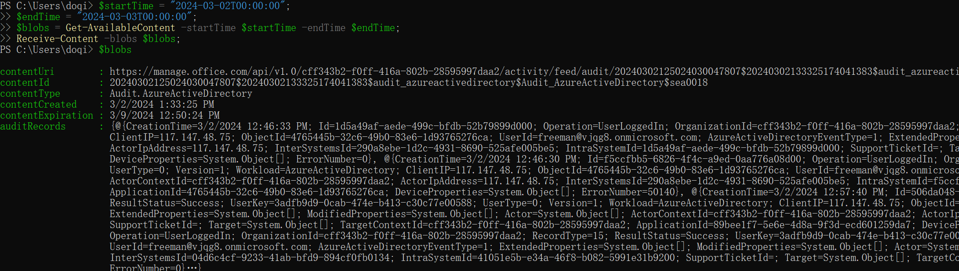
Demo: List available content and receive audit data
$startTime = "2024-03-05T00:00:00";
$endTime = "2024-03-06T00:00:00";
$blobs = Get-AvailableContent -startTime $startTime -endTime $endTime;
Receive-Content -blobs $blobs;

Slide 49
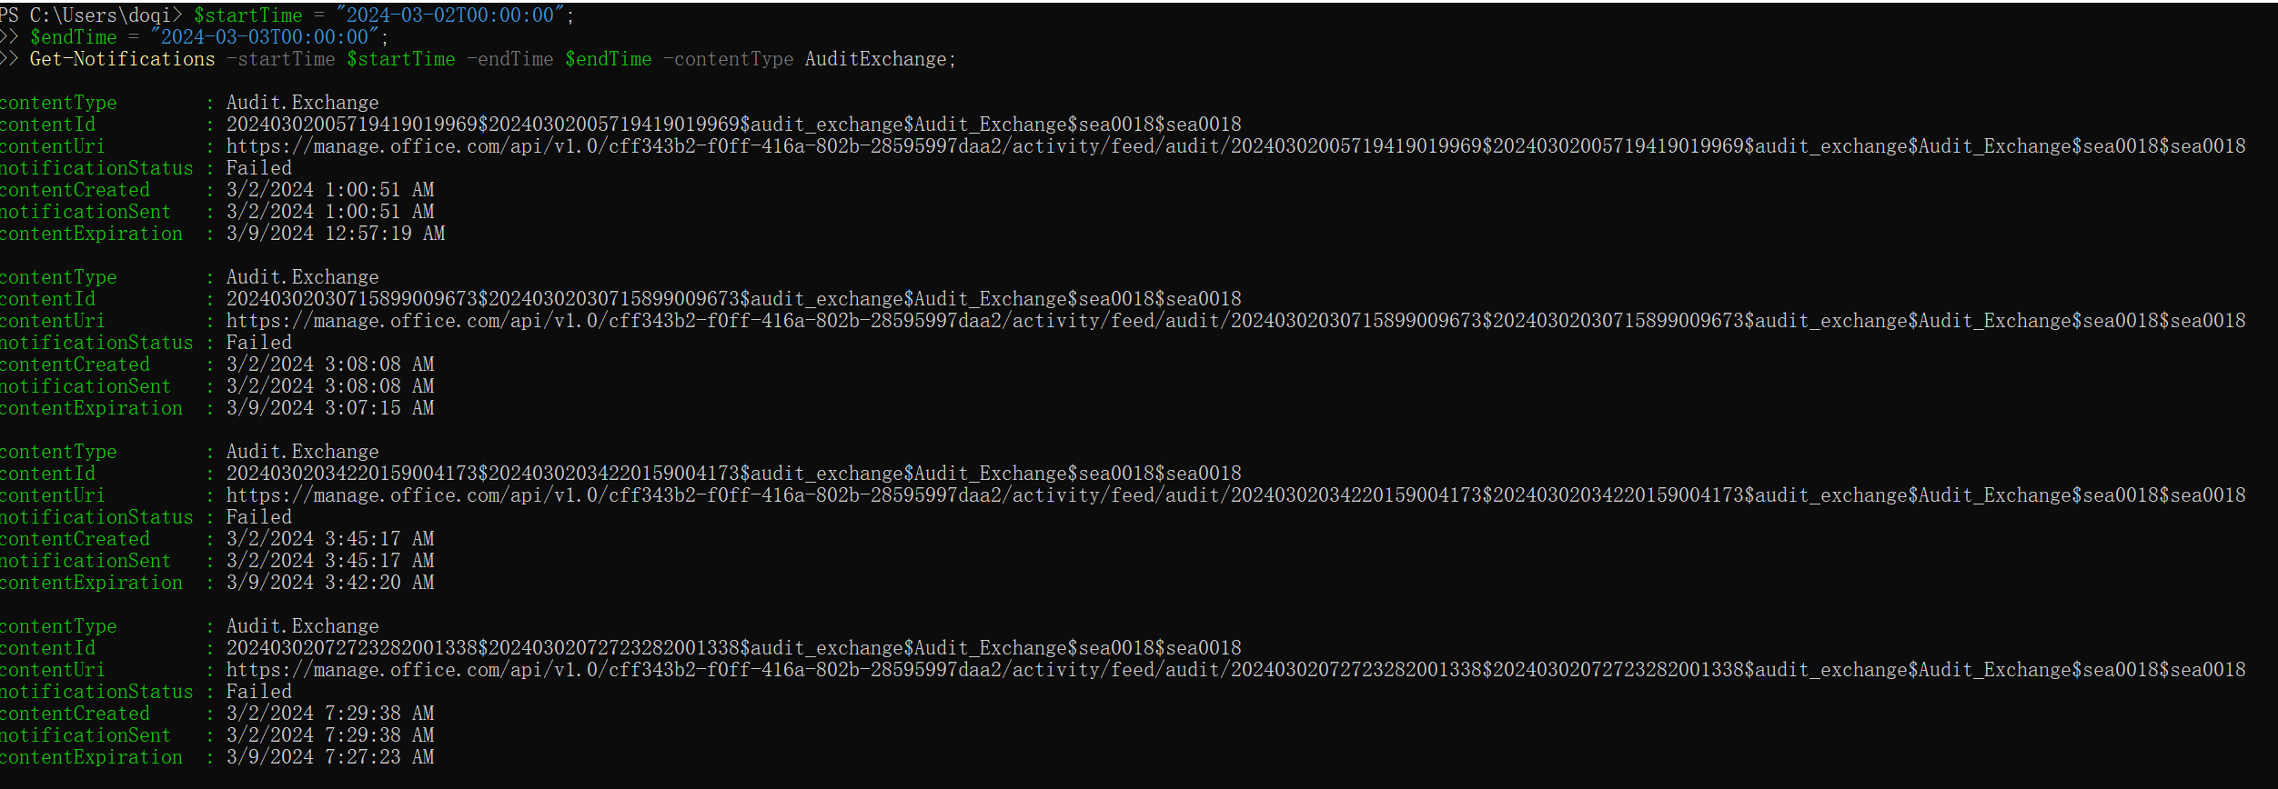
Demo: List the notifications
$startTime = "2024-03-02T00:00:00";
$endTime = "2024-03-03T00:00:00";
Get-Notifications -startTime $startTime -endTime $endTime -contentType AuditExchange;

Slide 50
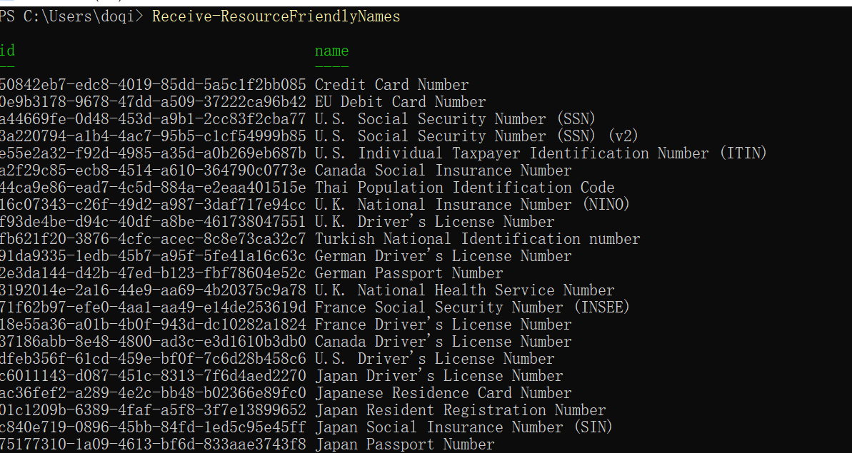
Demo: Receive the FriendlyNames for DLP Resource

Slide 51
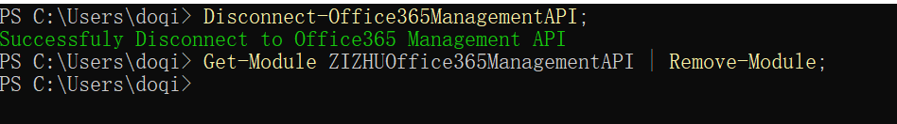
Demo: clean after usage
Disconnect-Office365ManagementAPI;
Get-Module ZIZHUOffice365ManagementAPI | Remove-Module;

Slide 52
Q&A

Slide 53
Thanks

